Slide 1

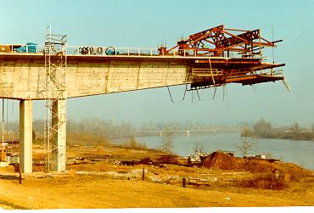
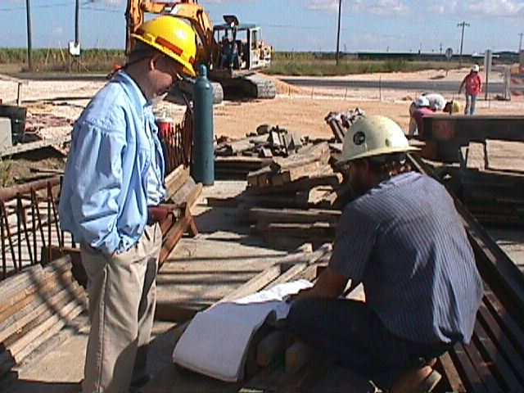
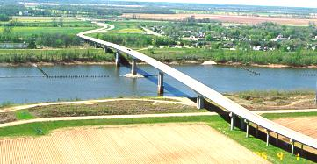
Automating LaDOTD CAD Submissions
Digital Submissions Within ProjectWise CAD Standards Perspective
International HEEP 2012
Presented by Hollis Ward Louisiana Department of Transportation and Development
and Marie Franklin - Altiva Software

Slide 2

Presentation Topics
  CAD Standards Compliance Standards / Tools
  ControlCAD Reports in ProjectWise
  Evolution of LaDOTD Digital Plan Delivery

Slide 3
CAD Standards Compliance Tools (LaDOTD and Consultants)

Slide 4
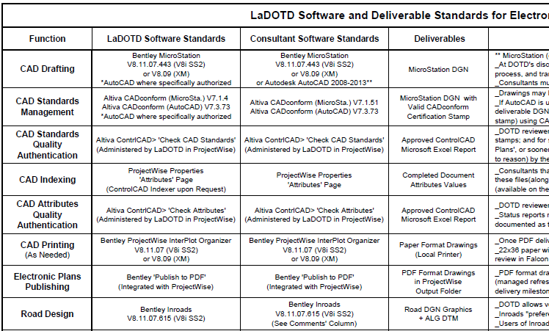
Software and Deliverable Standards
Standards also cover Electronic Survey, Hydraulics Drafting, Digital Signatures, PDF Plan Reader, Collaboration Platform

Slide 5
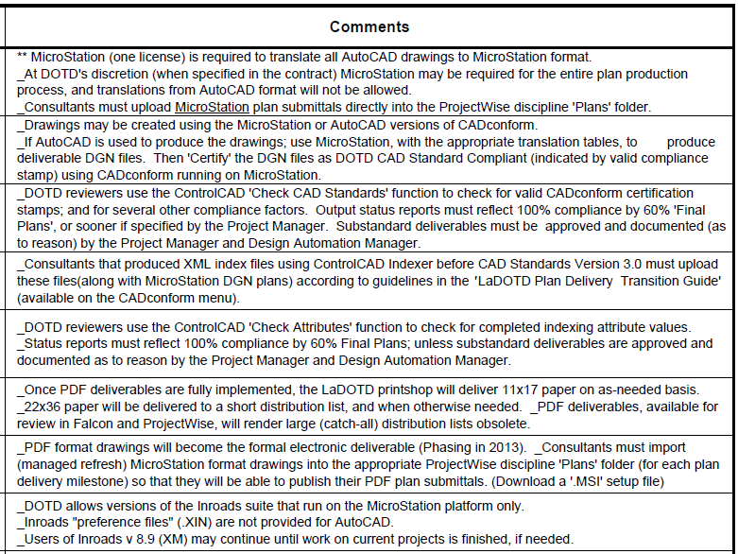
Software and Deliverable Standards
‘Comments’ column provides additional critical information about software and deliverable standards

Slide 6
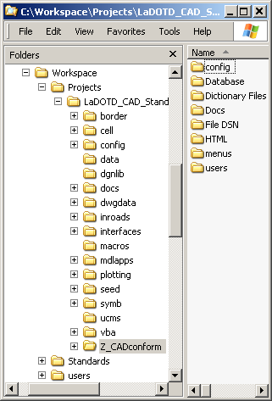
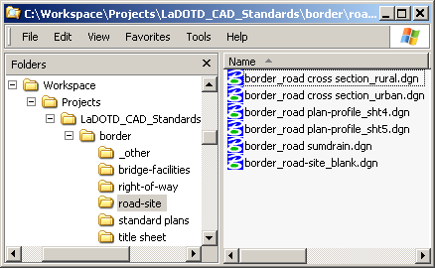
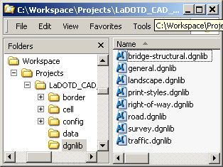
LaDOTD CAD Standards Resources
Workspace Overview
Borders
Level Libraries
Provides all of resources
and standards needed

Slide 7
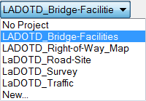
“Project” Workspace Selection List
Select ‘Project’ Workspace in MicroStation Manager

Slide 8
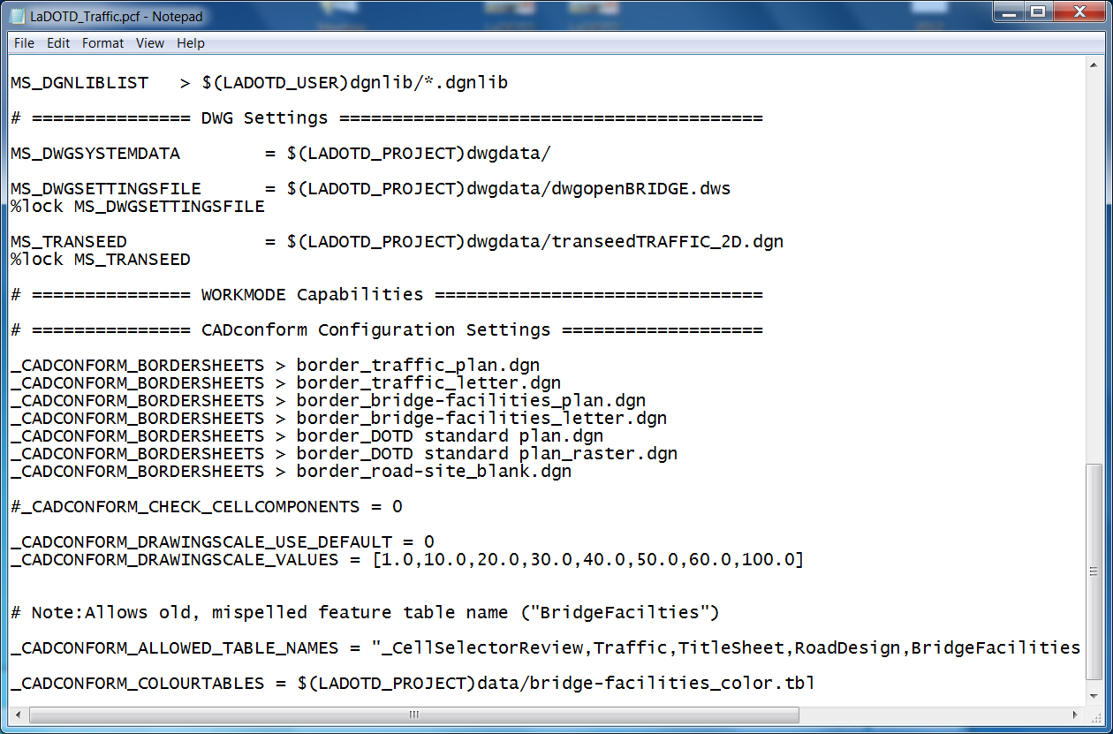
Example Project Config File (.PCF)
‘Project’ Workspaces have customized settings.
Project Config. + Master Config. = Environment

Slide 9

Altiva CADconform Toolkit
  Connect to Database
  Manage Users
  Manage Feature Tables
  Conform
  Generate Reports and Certify
  CADconform Draft

Slide 10
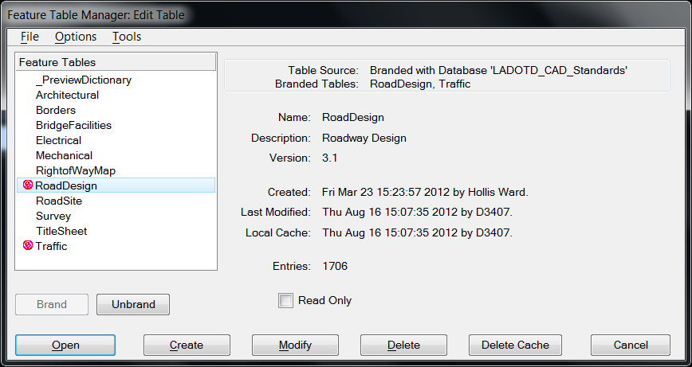
CADconform Feature Table Branding
“Brands” (red symbol) set default feature tables for seed files
Brands must be “Allowable” (Sprcified in ‘Project’ config file)

Slide 11
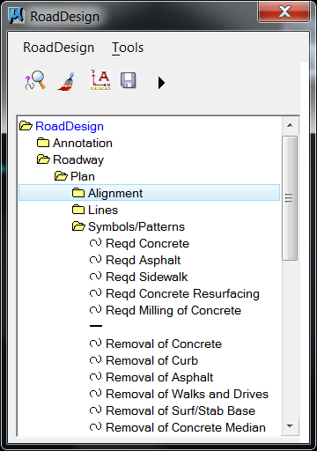
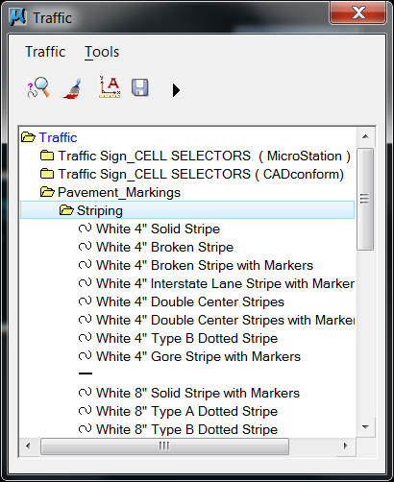
CADconform Drafting Menu
‘Long Menu’ Option – Road Design and Traffic (Example)

Slide 12
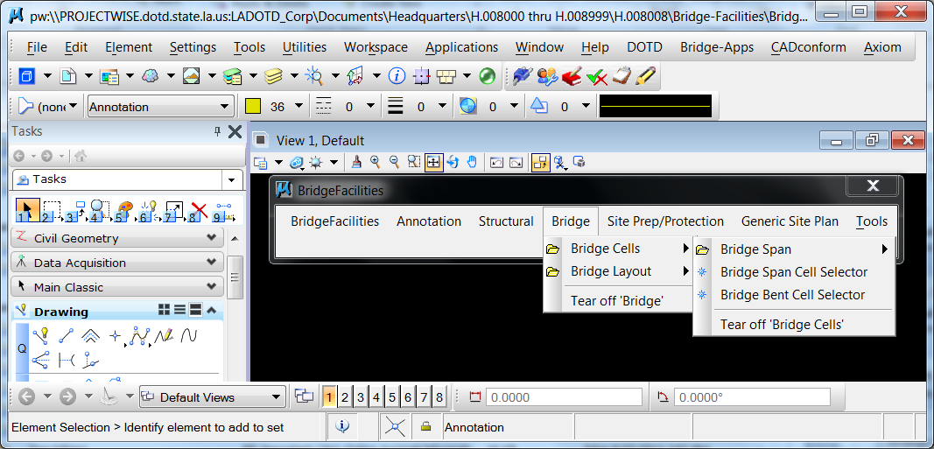
CADconform Drafting Menu
‘Short Menu’ > ‘Menus Across’ Option
Bridge Design

Slide 13
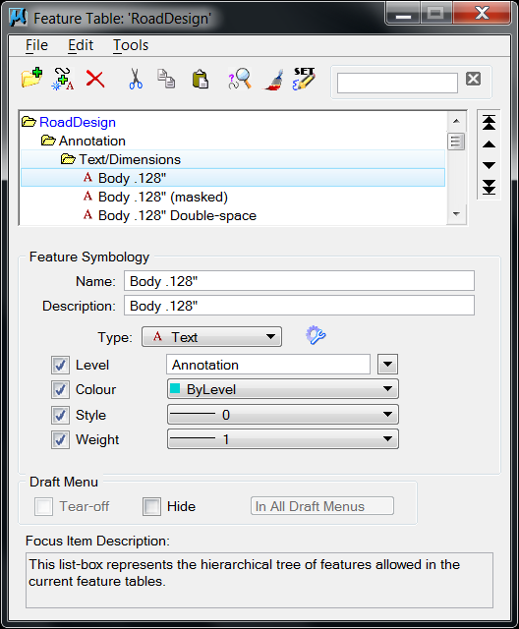
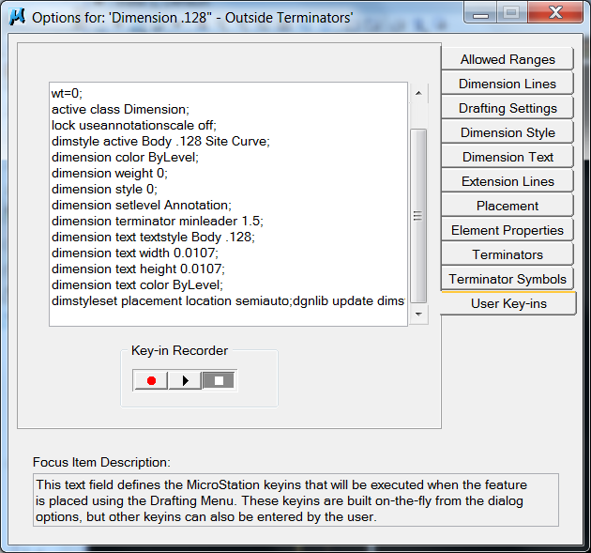
Example CADconform Feature Definition
Example Road Design Annotation Feature Definition
Tabs expand choices of attributes and commands
Feature settings enable macro creation on the fly

Slide 14
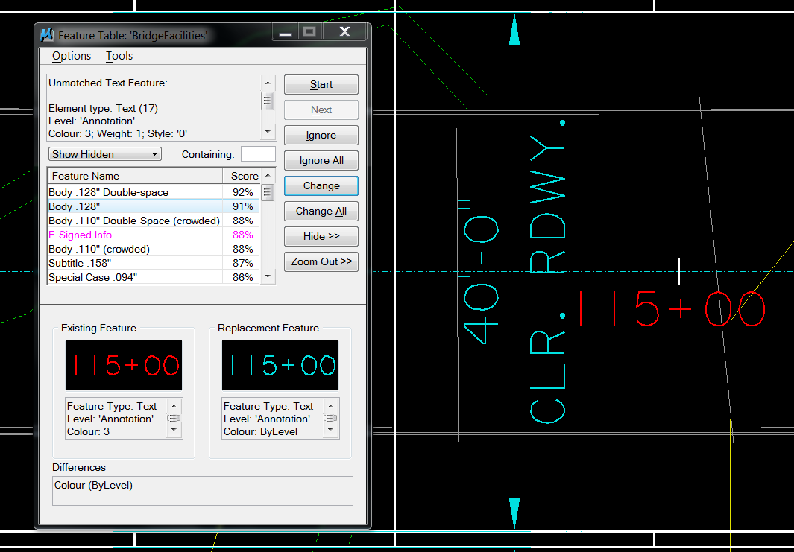
‘Conform’ Interactive Checker
‘Conform’ tool works somewhat like a spellchecker

Slide 15
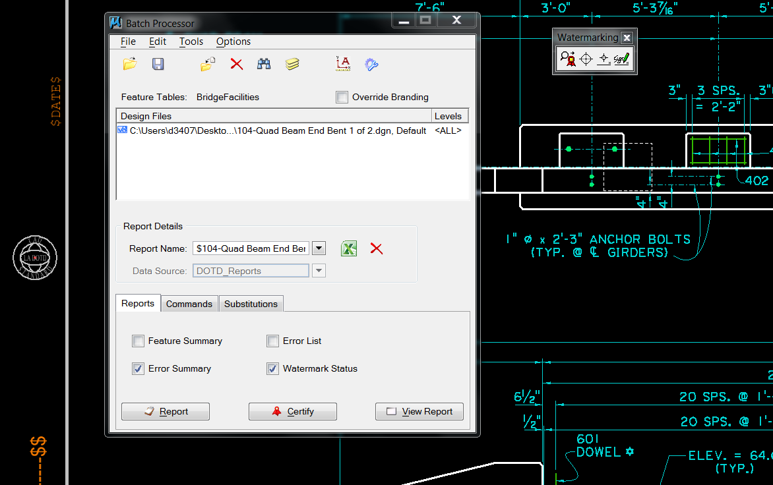
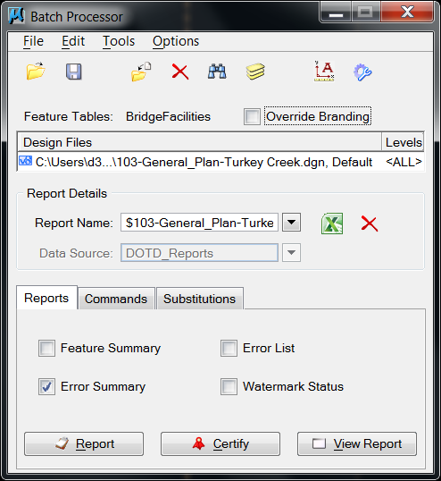
Batch Processor - Certify
Batch Processor ‘Certify’ command places certification stamp
Also used to generate Error Summary, Feature Summary, etc.

Slide 16
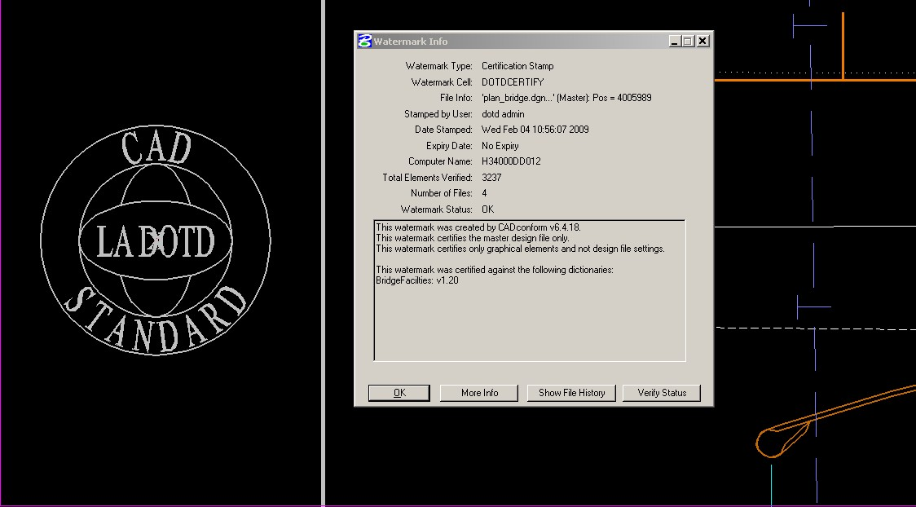
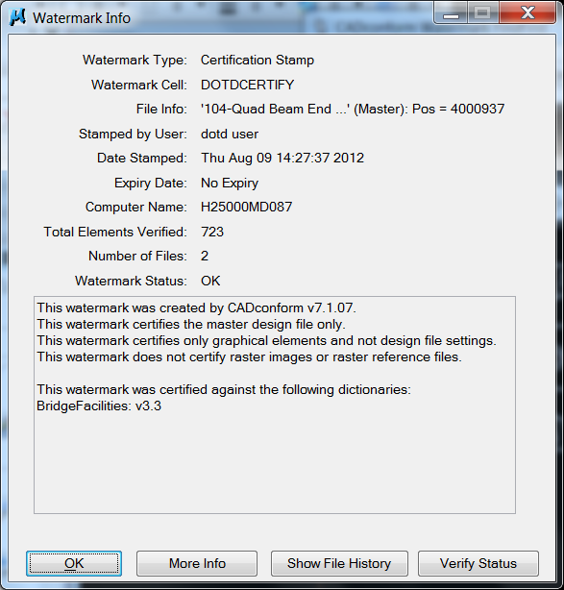
Standards Certification - Secure Watermark
Intelligence encoded stamp documents important details
ControlCAD checks for CAD Certification Stamp

Slide 17
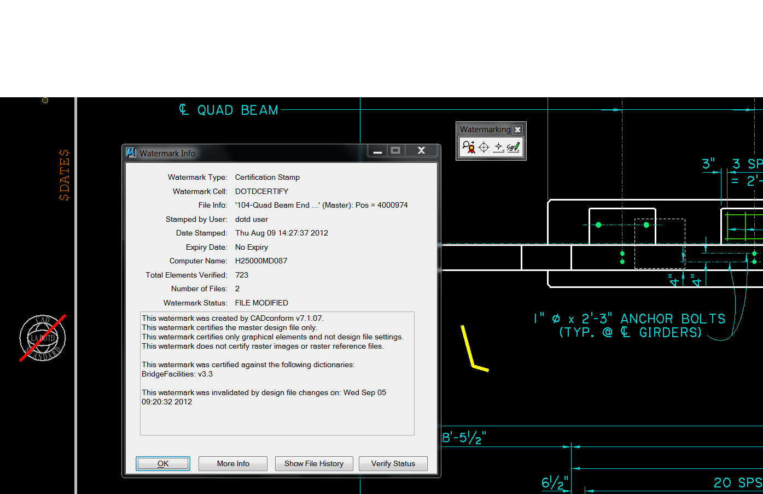
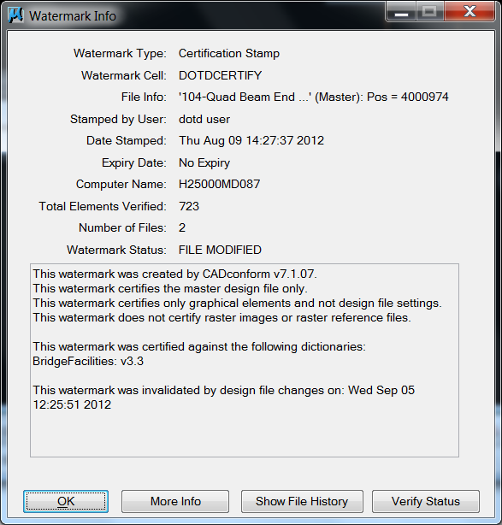
Watermark Invalidation
Standards Certification with Secure Watermark
‘Red slash or ‘x’ indicates watermark invalidation
File changes update status from “OK” to “File Modified”

Slide 18
Altiva ControlCAD Reports in ProjectWise

Slide 19
ControlCAD Reports Options”
Check Attributes
Check CAD Standards
Help About Reports
Email Reports

Slide 20
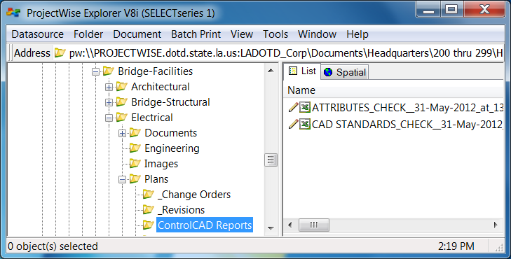
‘ControlCAD Reports’ Folder”
Reports folder is created when the first report is ordered
Reports are run for each discipline at each submittal milestone

Slide 21
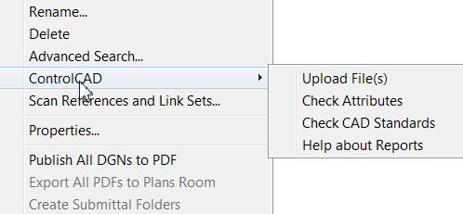
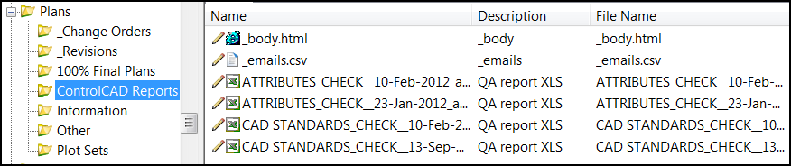
Generate ControlCAD Reports”
Select plan sheets or Plans folder and right-click
Select ‘ControlCAD’
Select ‘Check Attributes’ or ‘Check CAD Standards’

Slide 22
ControlCAD ‘Check CAD Standards’ Report”
Red fields indicate issues that need to be fixed
Provides overview of CAD standards and settings
Provides format for general review and comments
Required at each submittal benchmark

Slide 23
ControlCAD ‘Check CAD Standards’
Compliance Report for CAD Drawings in ProjectWise
(Replaces ControlCAD Submittal)
    Compliance Checks
CAD Certification Stamps present
Appropriate Feature Tables used
CAD Reference Files found
CAD File Header information valid (Working Units, etc.)
Borders, scales, fonts, styles required for PDF Publishing
E vidence of cheating, unexpected results, etc.
Provide timely feedback for Designers & Managers

Slide 24
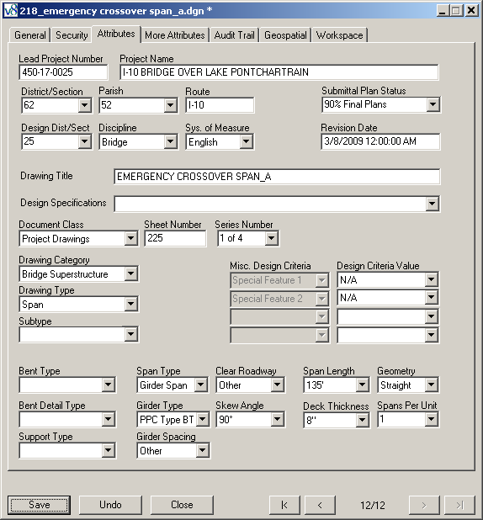
ProjectWise Attributes Page
ProjectWise Attributes Page
How do we ensure that attribution is complete?

Slide 25
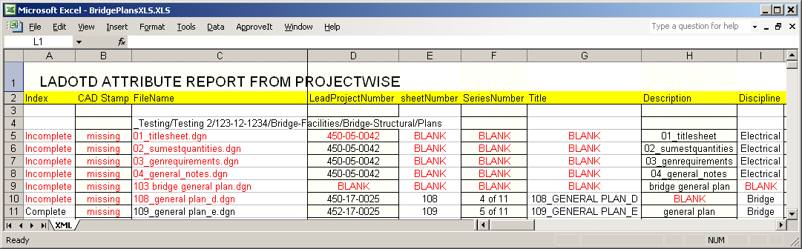
ControlCAD
‘Check Attributes’ Report”
Red text indicates issues that need to be fixed
Checks for attribute indexing completeness
Provides format for general review and comment
Required at each submittal benchmark

Slide 26
Advantages of ControlCAD Reports
    Provide feedback throughout the plan development process
    Bring order to the chaotic world of plan development
    After first project, reports generally speak for themselves
    Particularly important for Consultant plans
    Particularly important for “Slackers”
    Prevent unpleasant surprises at Final Plans !
    Prevent late plan delivery and late lettings
    Complete, compliant, high-quality final product is likely
    Leverages the ProjectWise collaboration environment !

Slide 27
Evolution of Digital Plan Delivery

Slide 28
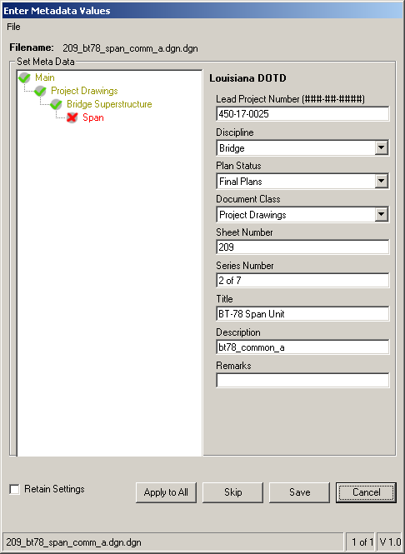
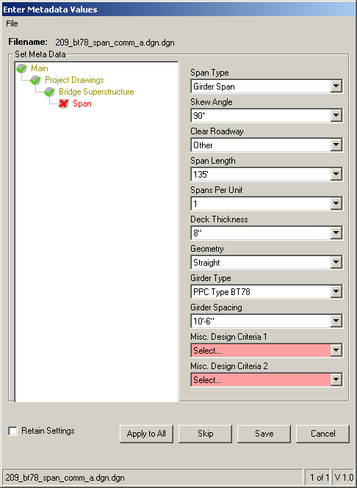
ControlCAD Indexer
Old: Creates XML index files for plan submittal upload into ProjectWise
New: Alternate indexing tool in ProjectWise (also a good training tool)
( Not available for Consultants in ProjectWise )

Slide 29
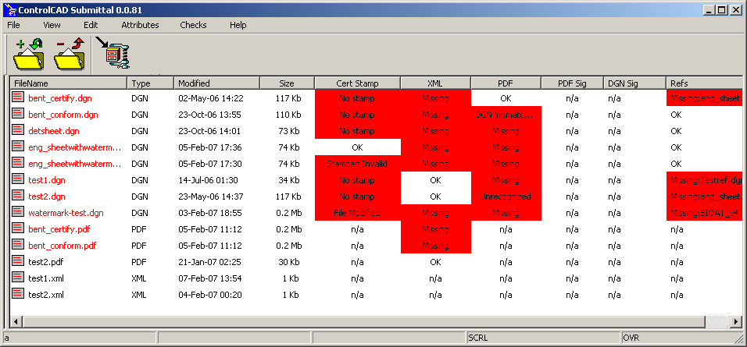
ControlCAD Submittal Creation Tool
Old: Creates plans archive for Consultant submittal to DOTD
Old: Checks Submittal Package against Compliance Settings
New: DOTD checks using Altiva ControlCAD Reports in ProjectWise
New: ‘Submittal’ is plan delivery tool for offline or special projects only

Slide 30
ProjectWise Attributes Page
New: Consultants must use ProjectWise Attribute Page

Slide 31
Integrated ProjectWise QA/QC Features
    Altiva CADconform
    Altiva ControlCAD Check CAD Standards’ Reports
    Altiva ControlCAD ‘Check Attributes’ Reports
    Altiva ControlCAD E Mail Reports
    Altiva ControlCAD Indexer (DOTD users only)
    Win-Win for DOTD and Consultant Partners

Slide 32
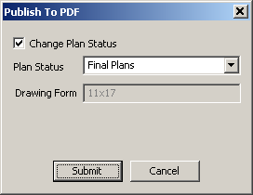
DOTD Internal Plan Delivery Workflow
CAD Plans Folder
Draft, Conform & Certify with CADconform. Index in ProjectWise.
CAD Plans Folder
ProjectWise Plan
Development
System
CAD Plans Folder
Falcon Electronic Plans Distribution Center
PDF Drawings
XML Attributes
“Watched Folder”
PDF Submittal Folder
Sign Final Plan Drawings with ApproveIt
PDF Drawing
XML Attributes
PDF - Adobe file format used for published documents
XML - File format used to store attribute values (indexing)
ProjectWise - Bentley Plan Development System
Falcon - tsaADVET Electronic Plans Distribution System
Watched Folder - Monitored by Falcon for incoming plans
PDF Submittal Folder
(“Final Plans”)

Slide 33
DOTD Consultant Plan Delivery Workflow (Abandoned Design)
ProjectWise Plan
Development
System
CAD Plans Folder
Falcon
Electronic Plans Distribution Center
DOTD Transmits
PDF Drawings &
XML Attributes
-Watched Folder-
PDF Submittal Folder
Too much happening outside of ProjectWise. Compliance remains a mystery until Finals
PDF - Adobe file format used for published documents
XML - File format used to store attribute values (indexing)
ProjectWise - Bentley Plan Development System
Falcon - tsaADVET Electronic Plans Distribution System
Watched Folder - Monitored by Falcon for incoming plans
DGN Drawings
PDF Drawings
XML Attributes
ControlCAD
Submittal Archive
Create PDF Drawing with Interplot
Sign Final Plans with ApproveIt
Consultant Plans Repository
Index PDF & DGN (ControlCAD Indexer)
Draft, Conform & Certify Final CAD DGN with CADconform

Slide 34
DOTD Consultant Plan Delivery Workflow
(Adopted Design)
ProjectWise Plan
Development
System
Falcon
Electronic Plans Distribution Center
DOTD Transmits
PDF Drawings &
XML Attributes
-Watched Folder-
CAD Plans Folder
PDF - Adobe file format used for published documents
XML - File format used to store attribute values (indexing)
ProjectWise - Bentley Plan Development System
Falcon - tsaADVET Electronic Plans Distribution System
Watched Folder - Monitored by Falcon for incoming plans
Consultants employ DOTD internal workflow to index, publish and sign.
Altiva ControlCAD Reports replace ControlCAD Submittal Archive
MicroStation
DGNs (Managed Export / Import )
External plan delivery tools; ControlCAD Indexer and ControlCAD Submittal are no longer used
Consultant Plans Repository
Draft, Conform & Certify DGN with CADconform

Slide 35
Changes to Consultant Plan Delivery
    Plan delivery workflow becomes very similar to DOTD’s
    ProjectWise Managed Export/Import for DGNs - each submittal
    Verify CAD standards with “Check CAD Standards” report
    Index in ProjectWise. Verify with “Check Attributes” report
    ControlCAD Submittal package replaced by ControlCAD Reports
    Task Managers can use the ControlCAD ‘Email Reports’ function to send selected reports to a predefined list of recipients.
    Reports start with first submittal. High level of compliance is expected in early submittals under normal circumstances.
    PDFs published and Digital Signatures applied using Bentley customized PDF Creation Service tools and workflows.

Slide 36


LaDOTD Digital CAD Submissions Within ProjectWise
Plan Delivery Tools and Workflow
(Comprehensive Overview)
International HEEP 2012
Presented by Hollis Ward DOTD Design Automation Manager

